Slide 1

Exploratory Data Analysis Project on Spinny Cars
Presented By:
Anil kumar Chinthakuntla
Batch No: 436
Location:Dilshuknagar

Slide 2
About me
Background?
I have completed my B.Tech graduation in Electrical Engineer from Annamacharya institute of technology and science
Any work experience
I have 6 years of work experience in Navigation field
LinkedIn profile URL
www.linkedin.com/in/anil-kumar-613978256
Git hub profile URL
https://github.com/anilkumarchinthakuntla

Slide 3
Agenda
Business Problem
Objective of the Project
Introduction of Spinny Website
Data column description
Data Extraction Using Web Scrape
Data Loading and Cleaning
Data visualization
Insights and pattern screenshots
Key analysis and Tech Support
Conclusion
Q&A Slide

Slide 4
Business Problem
Consumers looking to buy used cars often face uncertainty, lack of trust, and inconvenience when navigating the used car market. They struggle with issues like unclear pricing, hidden vehicle problems, unreliable sellers, and complex paperwork — all of which make the process stressful and risky

Slide 5
Objective of the Project
✔ Quality and Trust: Deliver pre-owned cars that pass a inspection and certification process so buyers feel confident in their purchase.
✔ Transparency: Provide fixed prices and clear vehicle information to eliminate negotiation hassles and uncertainty.
✔ Convenience: Support online browsing, home test-drives, online payments, and doorstep delivery.
✔ Post-Purchase Assurance: Offer warranties and return policies to reduce buyer risk and enhance peace of mind..

Slide 6
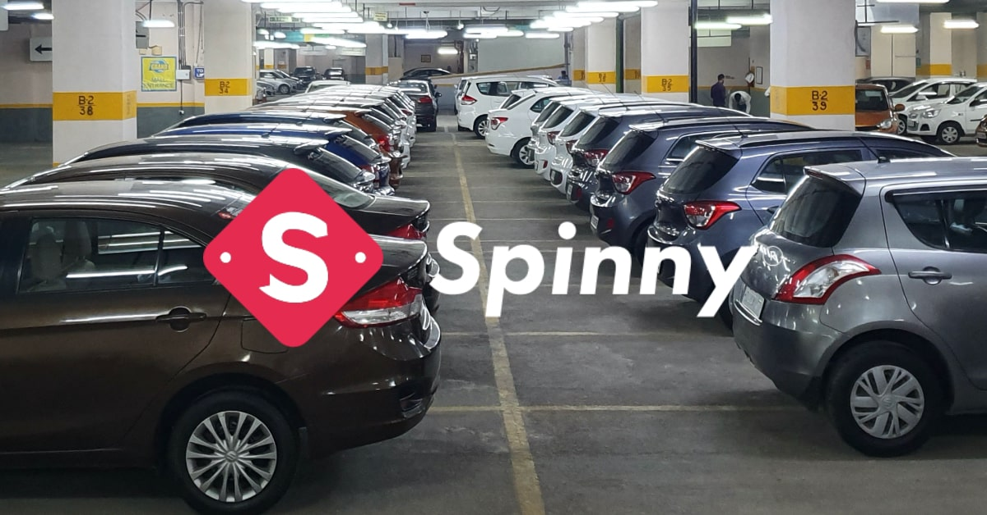
Introduction
Spinny is one of India’s leading online platforms for buying and selling certified used cars, offering a transparent and hassle-free experience.
This project involves web scraping used car data from the Spinny website using Python and BeautifulSoup.
The collected dataset includes important attributes such as brand, model, year, fuel type, transmission, kilometers driven, price, and location..
Through Exploratory Data Analysis (EDA), the project aims to uncover insights such as popular car brands, price variations across locations, and factors influencing used car prices.
Insights derived from this analysis help in understanding the used car market and support better decision-making for buyers, sellers, and businesses

Slide 7
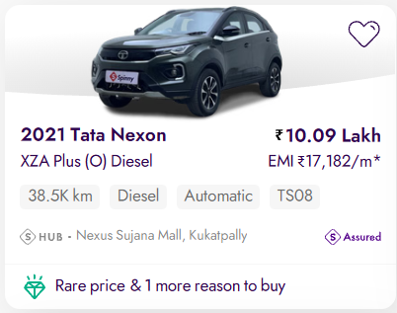
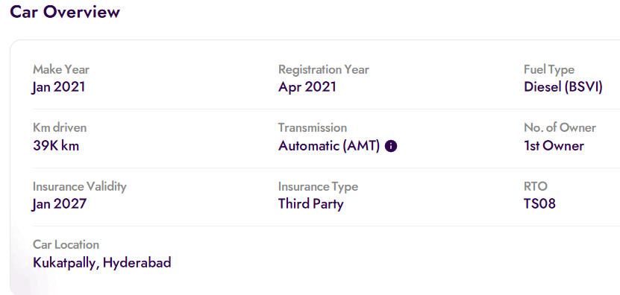
Data Column Description
Year – Manufacturing year of the vehicle, indicating how old the car is.
Brand – The manufacturer of the car (e.g., Maruti, Hyundai, Kia).
Model – The specific model name of the vehicle under a brand (e.g., Swift, Creta).
Variant – The trim or configuration of the model defining features, engine, and gearbox options.
Price – Listed selling price of the used car, expressed in lakhs of INR.
KM Driven – Total distance the car has been driven, reflecting usage and wear.
Fuel – Type of fuel used by the vehicle such as Petrol, Diesel, or CNG.
Transmission – Gearbox type indicating whether the car is Manual or Automatic.
Registration – Regional Transport Office (RTO) code representing the vehicle’s registration state and district.
Location – City or showroom location where the car is available for sale

Slide 8
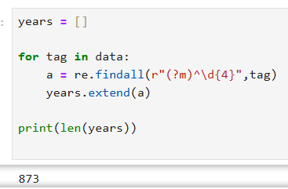
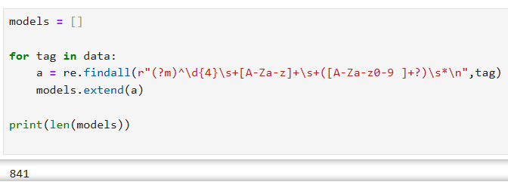
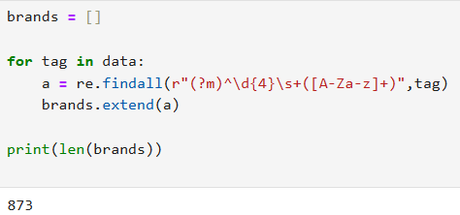
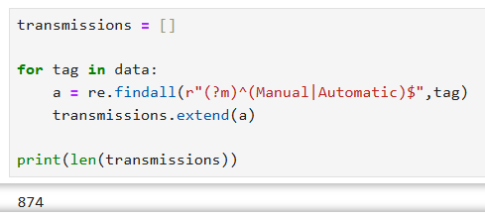
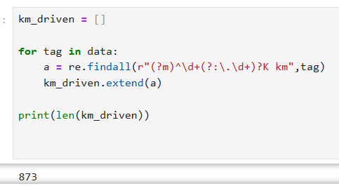
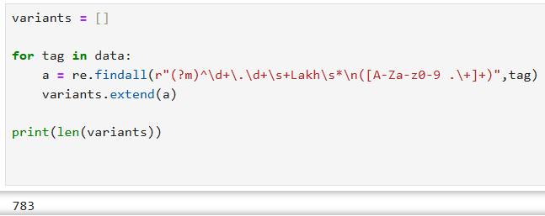
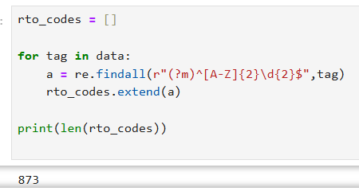
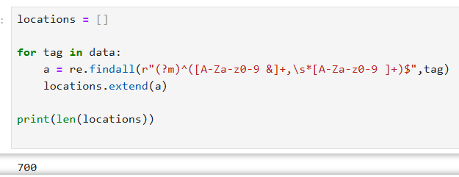
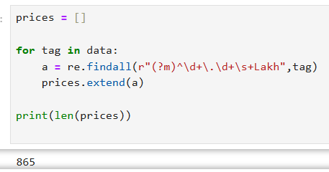
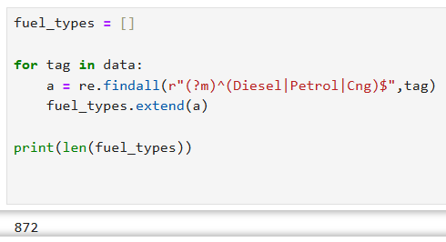
Data Extraction Using Web Scraping

Slide 9
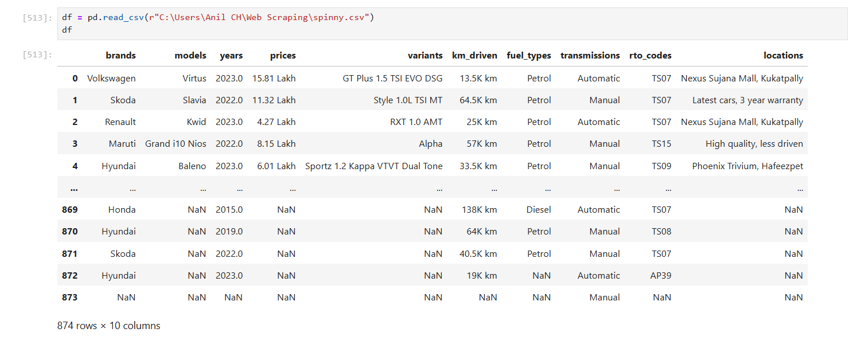
Creating Data Frame using Pandas

Slide 10
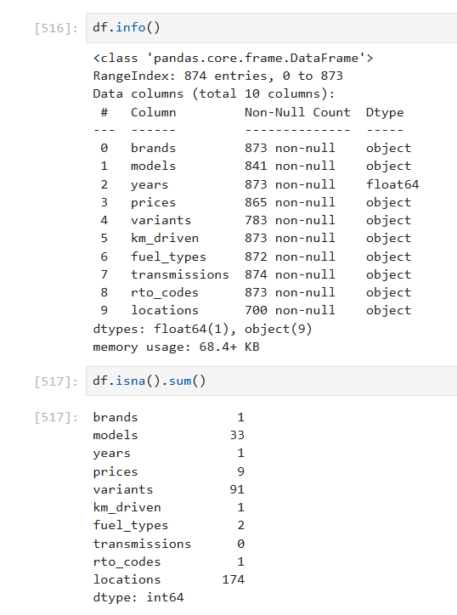
Data Loading

Slide 11
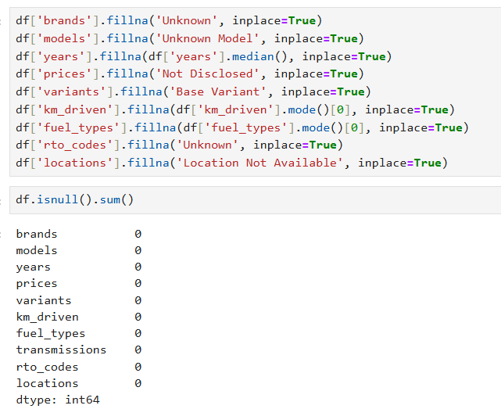
Data Cleaning

Slide 12
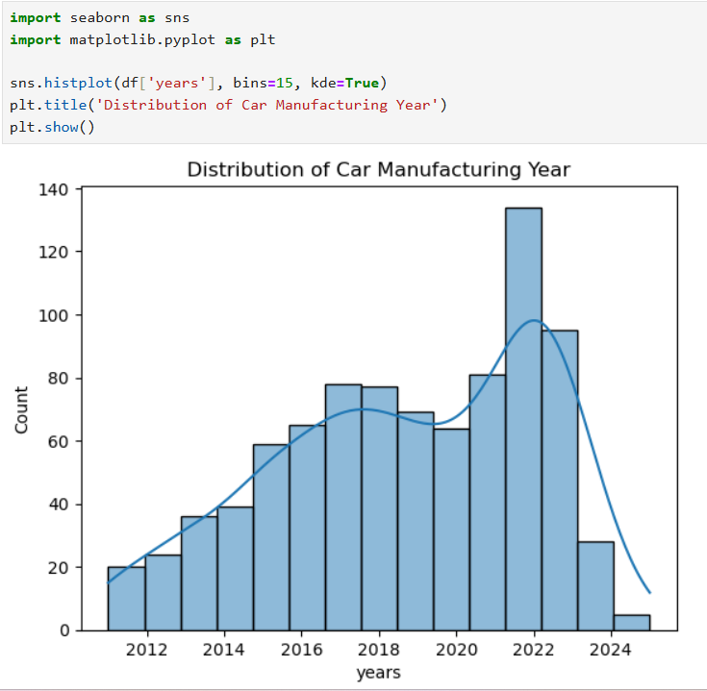
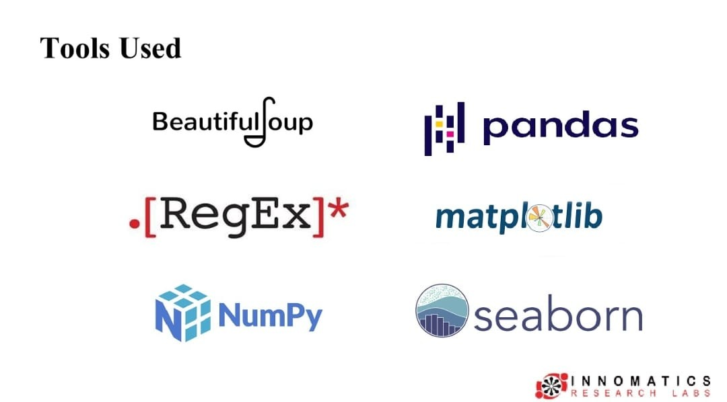
Data visualization
Data visualization is the graphical representation of data and information using visual elements like charts, graphs, maps, and dashboards to make complex datasets understandable, reveal patterns, trends, and outliers, and facilitate faster, data-driven decision-making for both technical and non-technical audience

Slide 13
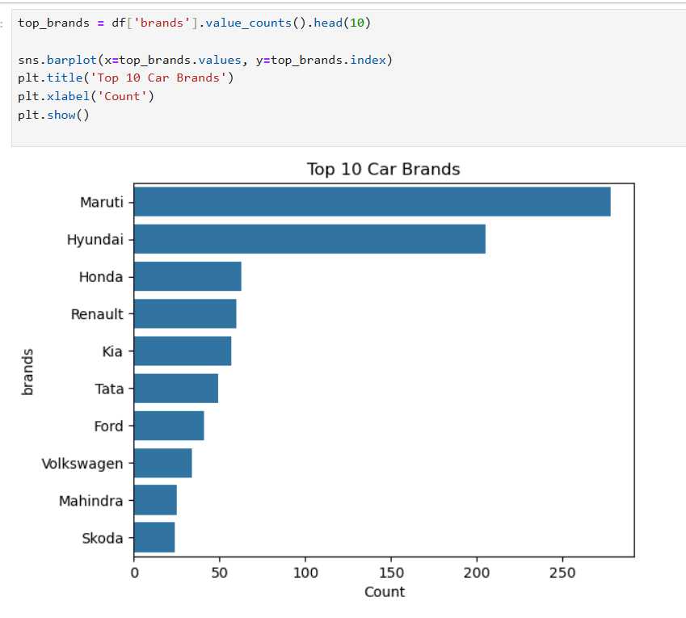
Top Brands

Slide 14
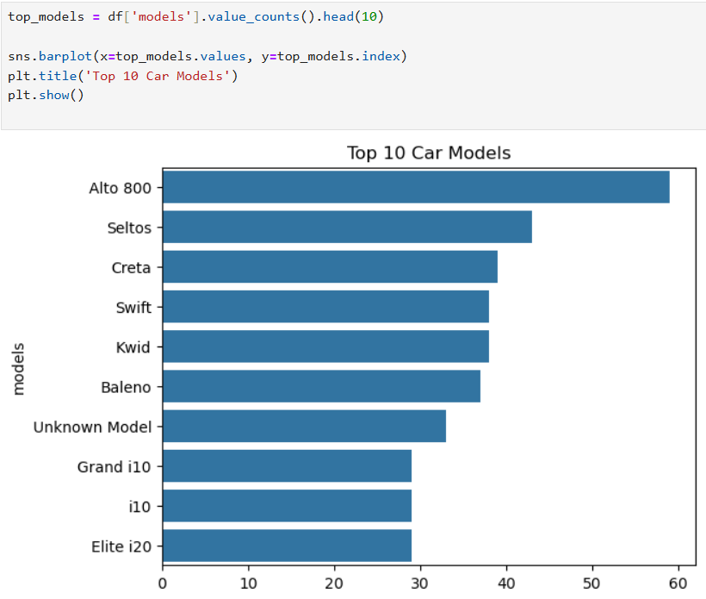
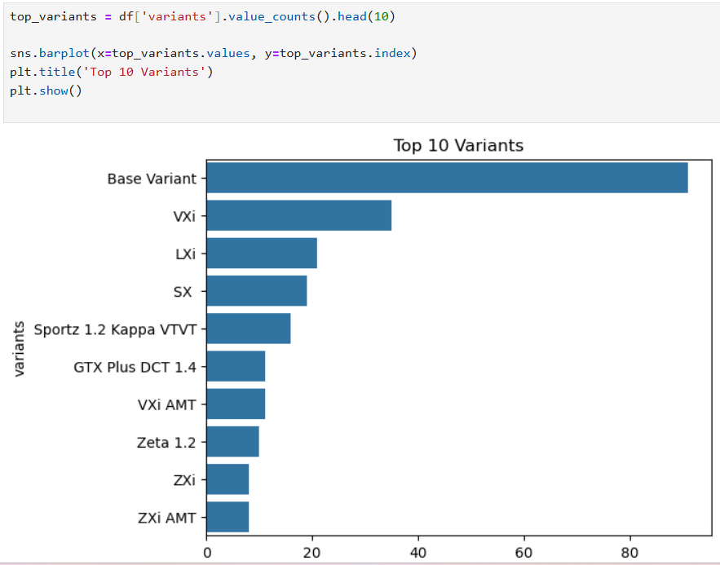
Top Models and Top Variants

Slide 15
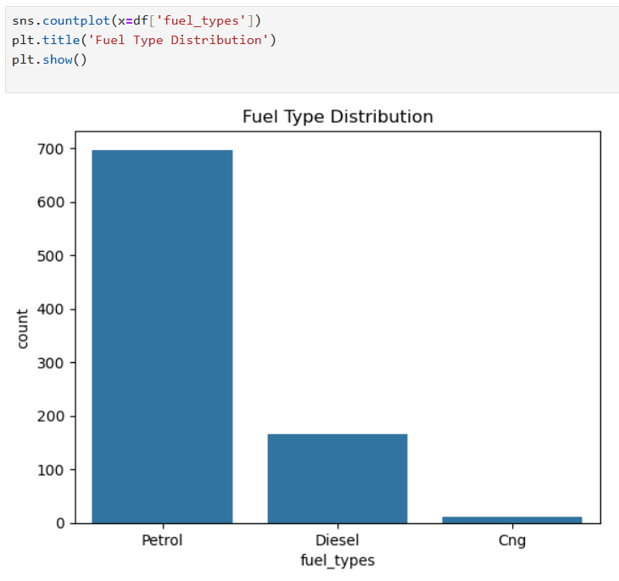
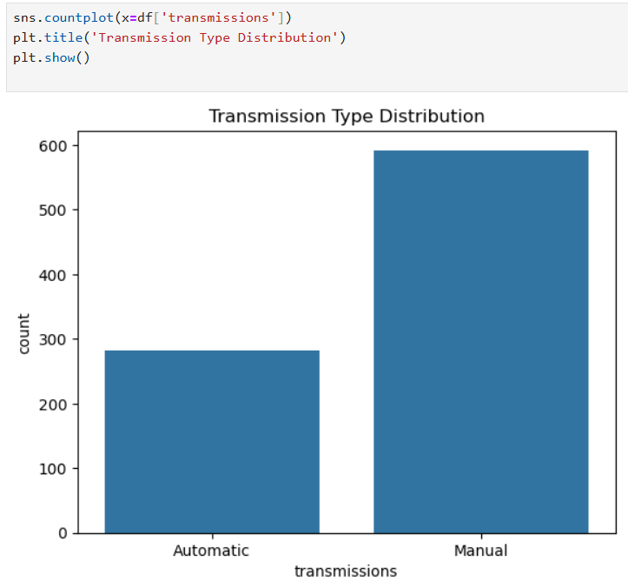
Fuel Type and Transmission

Slide 16
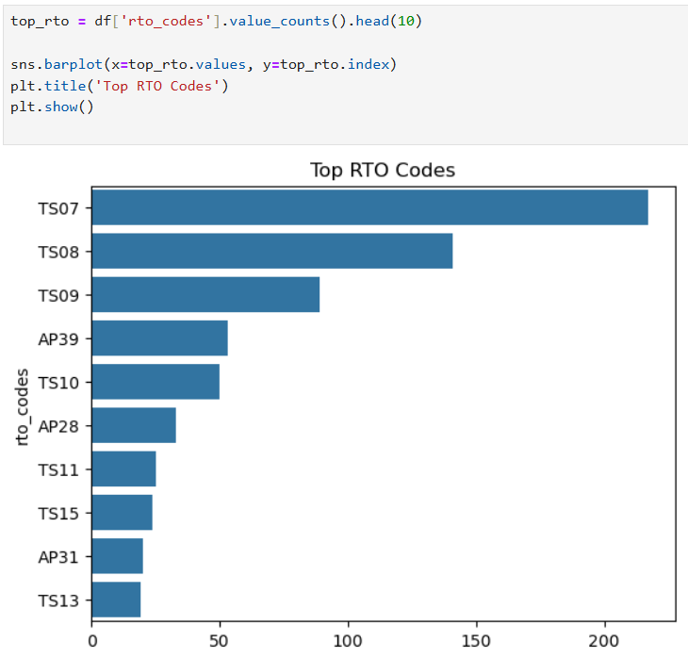
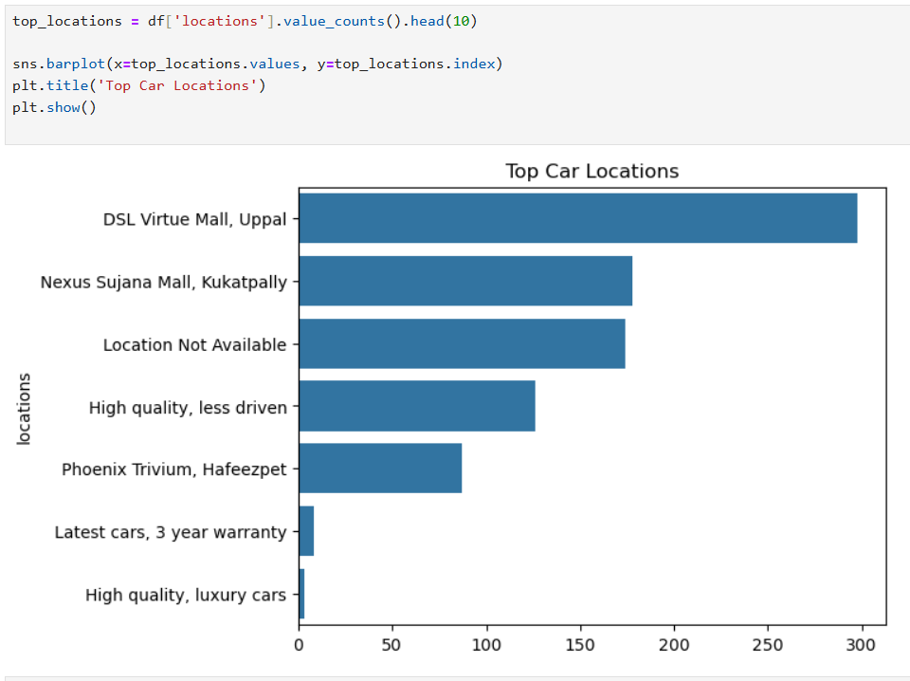
Top RTO and Location

Slide 17
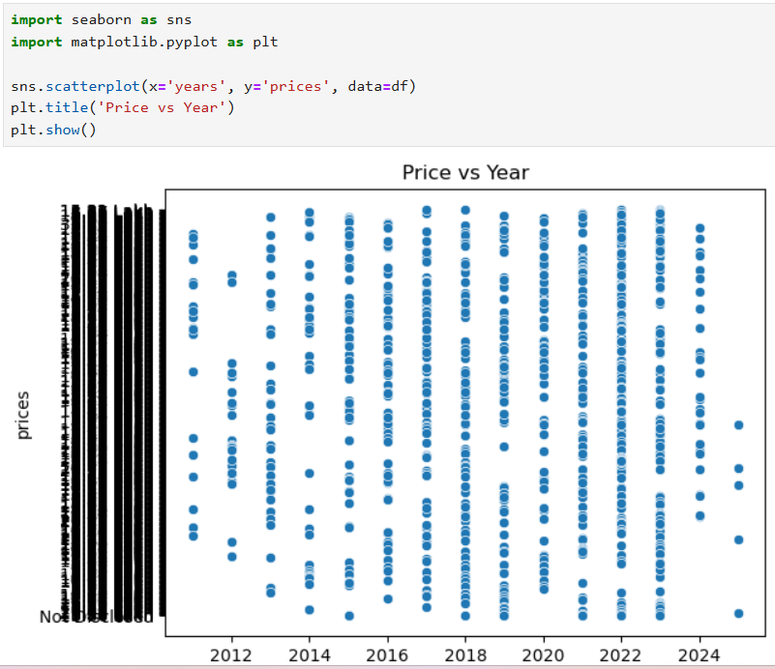
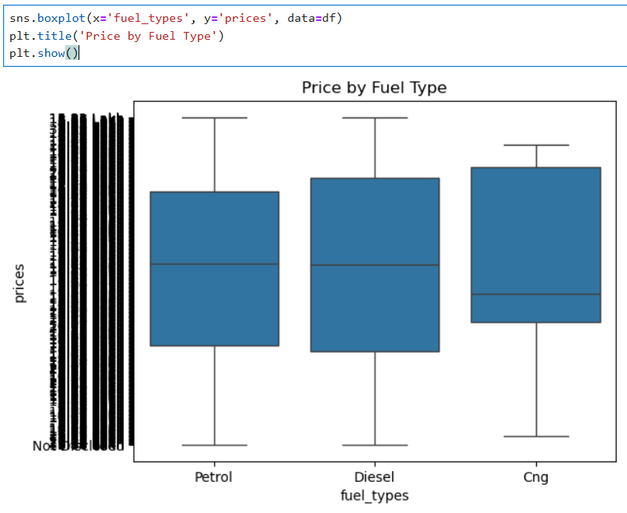
Comparision Price with Year,Fuel Type

Slide 18
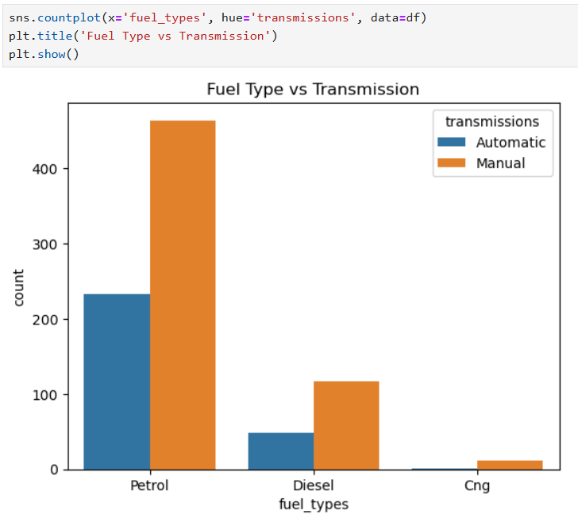
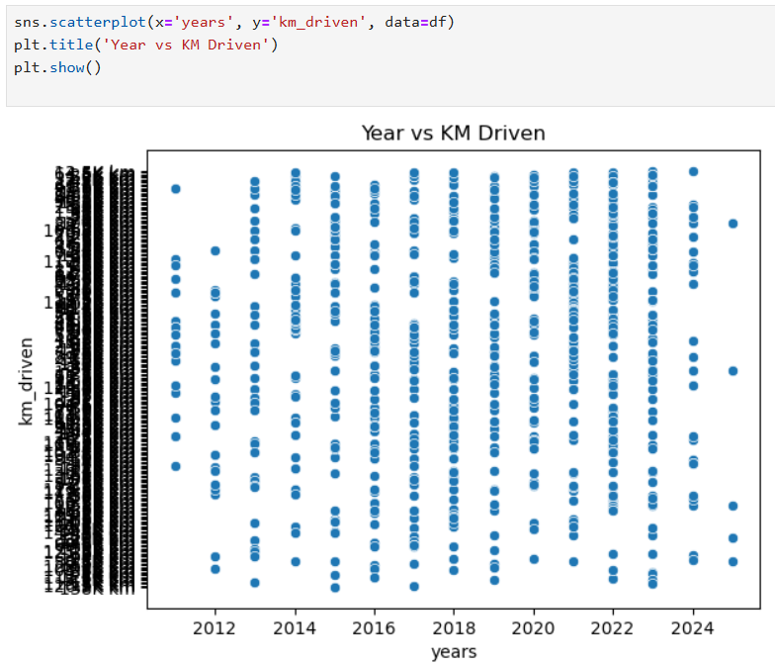
Fuel type Vs Transmission
Year Vs KM Driven

Slide 19
💻 Tech Stack Used:
🕸️ Selenium, WebDriver Manager
🥄 BeautifulSoup
🐍 Python
📊 Pandas, NumPy
📈 Matplotlib, Seaborn
📌 Key Insights:
🚗 Maruti & Hyundai dominate the used-car market
⛽ Petrol cars have the highest share
🕹️ Manual transmission still leads, but automatic is rising
📉 Higher KMs → Lower price trend confirmed
📆 Cars from 2021–2022 have the highest availability

Slide 20
Conclusion
Project involved web scraping used car data from Spinny using Python and BeautifulSoup.
Exploratory Data Analysis (EDA) helped identify key factors influencing car prices, such as brand, model year, mileage, fuel type, transmission, and location.
The analysis showed that newer cars with lower kilometers driven retain higher resale value.
Brand popularity and city-wise demand were found to significantly impact pricing trends.
Overall, the project provides valuable market insights that support informed decision-making for buyers, sellers, and business

Slide 21


Slide 22

THANK YOU

